Slide 1
Practical Genomics with Apache Spark Spark Summit Europe, 26 October 2017 Tom White @tom_e_white

Slide 2
About Me
Data Science Team at Cloudera
Apache Hadoop Committer, PMC Member, Apache Member
Author of “Hadoop: The Definitive Guide”

Slide 3
What is genomics?

Slide 4
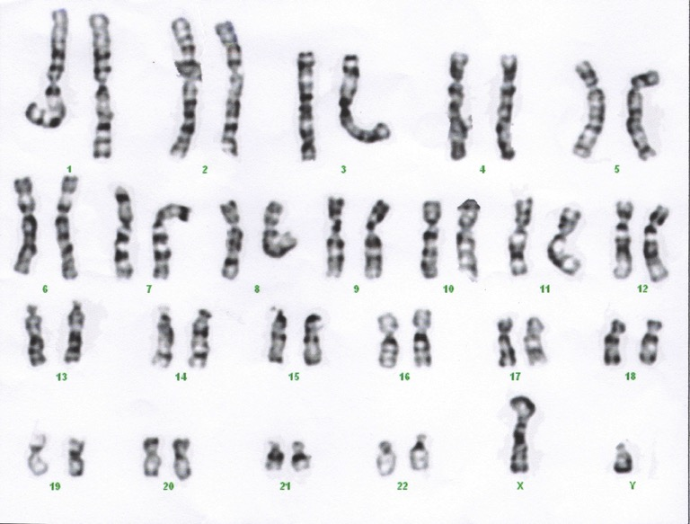
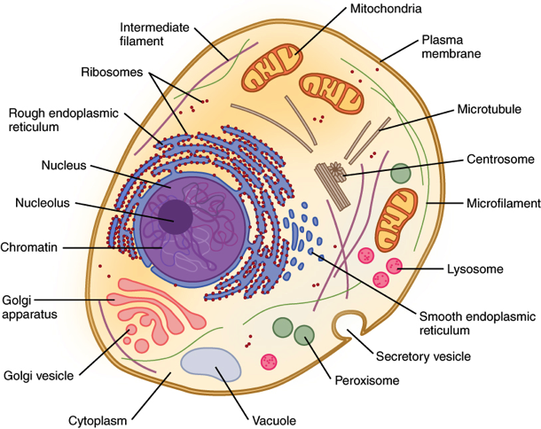
Organism
Cell
Genome
Notes:
Fundamentally, we’re interested in studying individuals (and populations of individuals)
But each individual is actually a population: of cells
But each of those cells has, ideally, an identical genome.
The genome is a collection of 23 linear molecules. These are called ‘polymers,’ they’re built (like Legos) out of a small number of repeated interlocking parts – these are the A, T, G, and C you’ve probably heard about.
The content of the genome is determined by the linear order in which these letters are arranged. (Linear is important!)

Slide 5
Notes:
Without losing much, assume that our genomes are contained on just a single chromosome.
Now, not only do all the cells in your body have identical genomes…
[ADVANCE]

Slide 6
Reference chromosome
Location
Notes:
We can define a concept of ‘location’ across chromosomes.
This is possibly the most important concept in genome informatics, the idea that DNA defines a common linear coordinate system.
This also means that we can talk about differences between individuals in terms of diffs to a common reference genome.
But where does this reference genome come from?

Slide 7
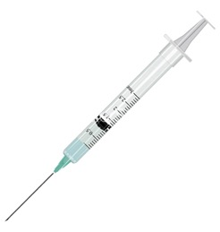
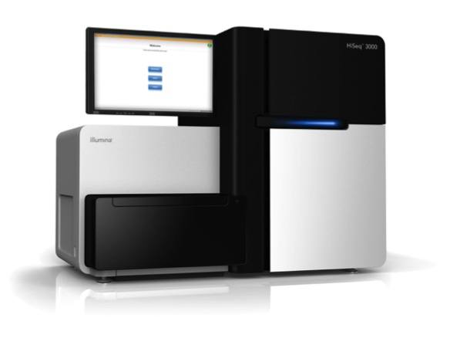
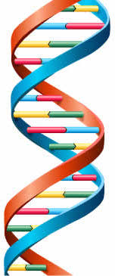
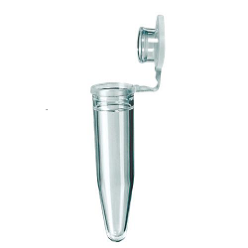
>read1
TTGGACATTTCGGGGTCTCAGATT
>read2
AATGTTGTTAGAGATCCGGGATTT
>read3
GGATTCCCCGCCGTTTGAGAGCCT
>read4
AGGTTGGTACCGCGAAAAGCGCAT
Bioinformatics!

Slide 8
Reads and Variants
Reads are fragments of DNA that are artifacts of the DNA sequencing process
We combine them together (with computers) to reconstruct an individual’s genome
An implementation detail
Variants are parts of the genome where individuals DNA differs
VCF ≈ diff reference individual
Variants are what scientists are interested in

Slide 9
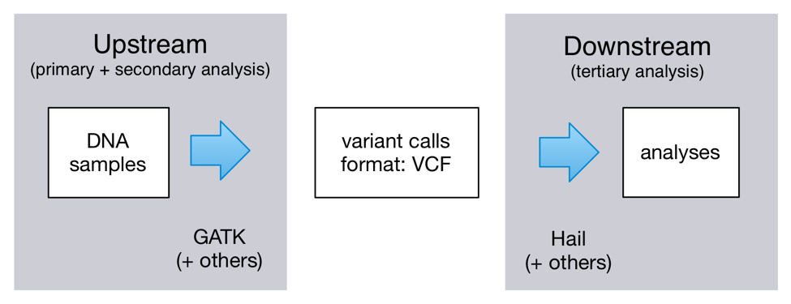
The Analysis Pipeline

Slide 10
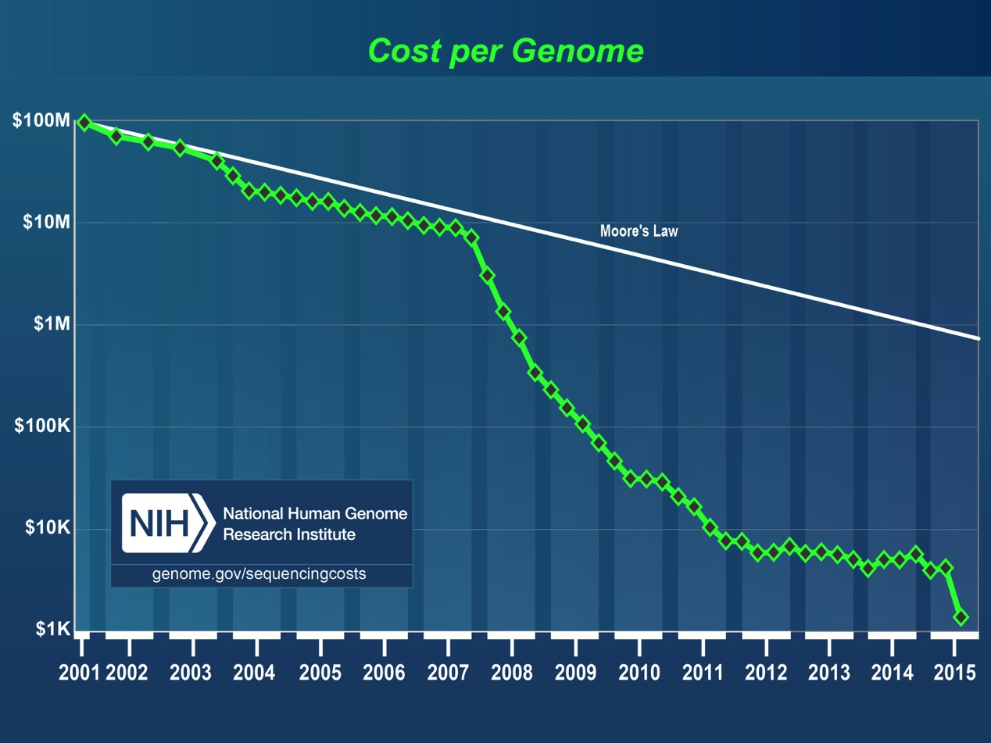
Notes:
DNA SEQUENCING
If satellites provide images of the world for cartography, sequences are the microscopes that give you “images” of the genome.
Over past decade, massive EXPONENTIAL increase in throughput (much faster than Moore’s law)

Slide 11
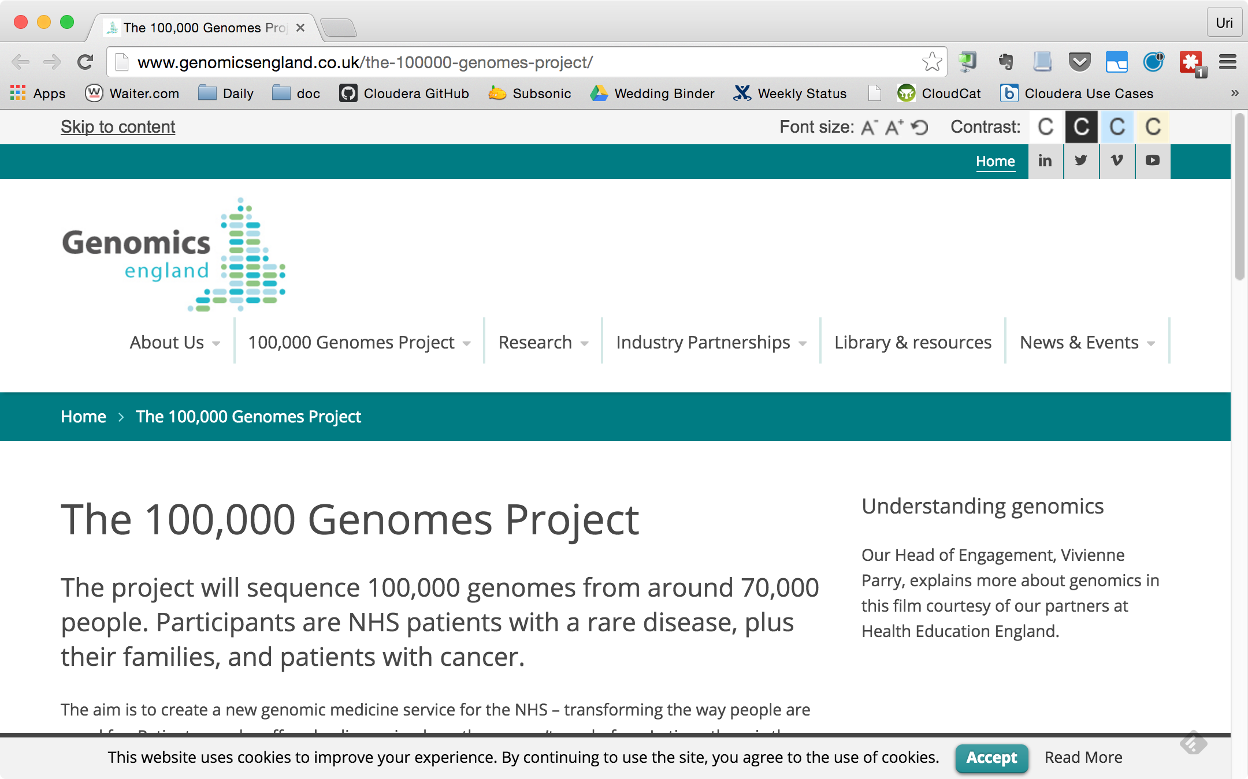
Notes:
SCALE!
New levels of ambition for large biology projects.
100k genomes at Genomics England in collaboration with National Health Service.
Raw data for a single individual can be in the hundreds of GB
But even before we hit that huge scale (which is soon)…

Slide 12
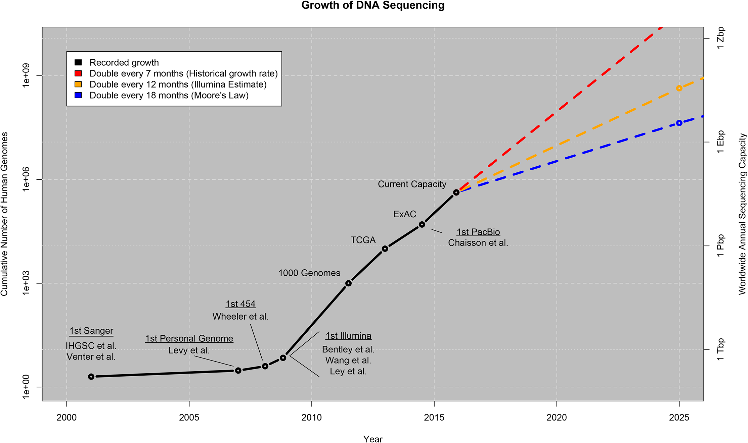
Notes:
DNA SEQUENCING
If satellites provide images of the world for cartography, sequences are the microscopes that give you “images” of the genome.
Over past decade, massive EXPONENTIAL increase in throughput (much faster than Moore’s law)

Slide 13
“Big Data: Astronomical or Genomical?”
“We therefore estimate between 100 million and as many as 2 billion human genomes could be sequenced by 2025... Indeed, this number could grow even larger, especially since new single-cell genome sequencing technologies are starting to reveal previously unimagined levels of variation, especially in cancers, necessitating sequencing the genomes of thousands of separate cells in a single tumor.”
http://journals.plos.org/plosbiology/article?id=10.1371/journal.pbio.1002195

Slide 14
GATK: Scalable Variant Discovery

Slide 15
Pipelines
Alignment
Dedup
Recalibrate
QC/Filter
Variant
Calling
Variant
Annotation

Slide 16
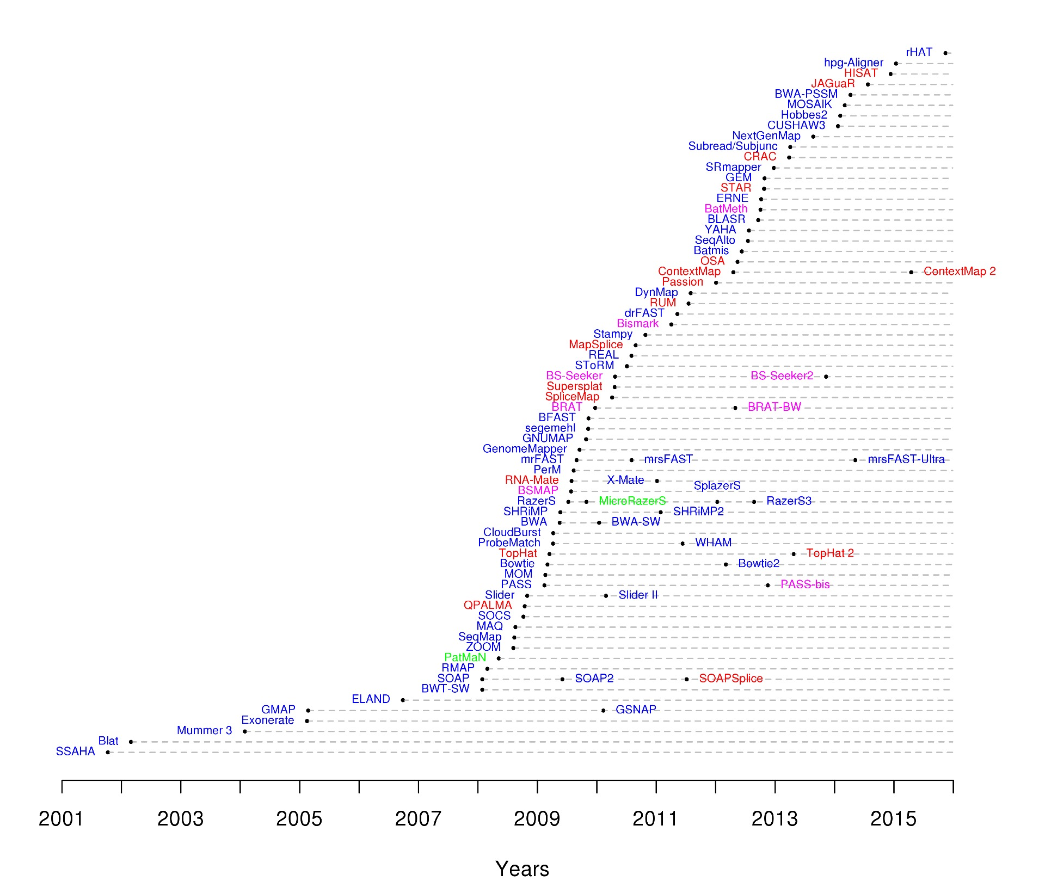
Alignment
Reads from the sequencer are unaligned
Alignment (or mapping) is the process of assigning a position to each read
Not just exact string matching against reference, due to variation
Many aligners!
Image from https://www.ebi.ac.uk/~nf/hts_mappers/

Slide 17
BWA-MEM and Spark
BWA family of aligners are very popular
Based on backward search with Burrows–Wheeler Transform
Alignment is embarrassingly parallel
BwaSpark is a Spark program that runs BWA-MEM in parallel on a cluster
Uses JNI to call BWA-MEM C library
Each task runs BWA-MEM on a partition of reads

Slide 18
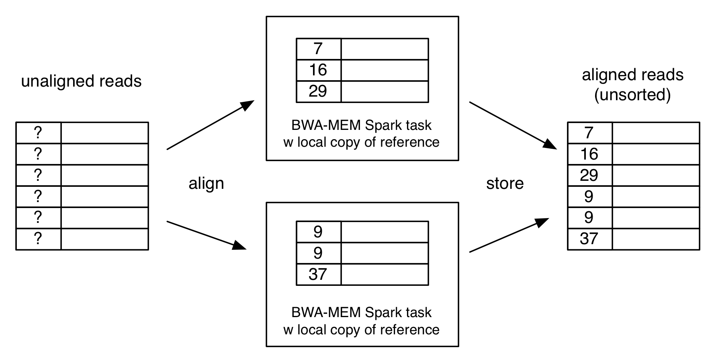
BwaSpark

Slide 19
Mark Duplicates
Sequencing is noisy, so often the same DNA fragment is sequenced multiple times
Mark Duplicates finds duplicate reads to avoid double counting
Deduplication is essentially a big sort – perfect for Spark
GATK3 has custom on-disk sorting algorithm – not scalable

Slide 20
MarkDuplicatesSpark

Slide 21
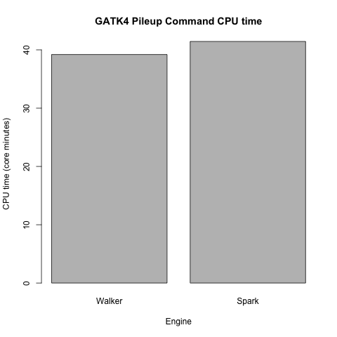
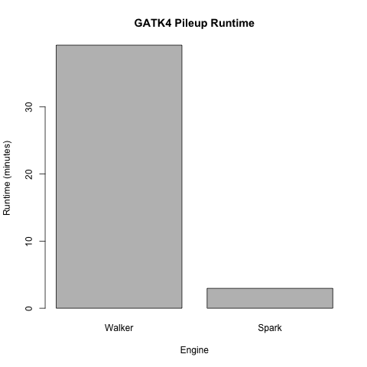
Performance: CPU vs wall clock time

Slide 22
Back to the Pipeline
Alignment
Dedup
Recalibrate
QC/Filter
Variant
Calling
Variant
Annotation

Slide 23
Performance: trying things you didn’t think were possible
With no prior experience of Spark, a team at the Broad were able to write a GATK4 Spark tool for analyzing structural variants that hadn’t been attempted on GATK3 due to its computational complexity, and get it running at what they estimated was one or two orders of magnitude faster than it would have been on GATK3.

Slide 24
Hail: Scalable Genomic Data Analysis

Slide 25
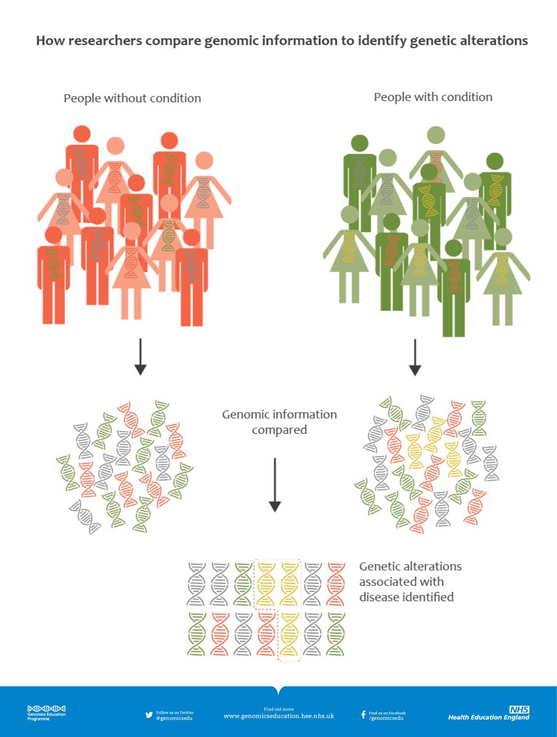
Genetic Trait Associations
Association studies look for statistical associations between genetic variation and phenotypic traits
Most disease is polygenic
Challenge is to do so for 100K+ individuals across the whole genome

Slide 26
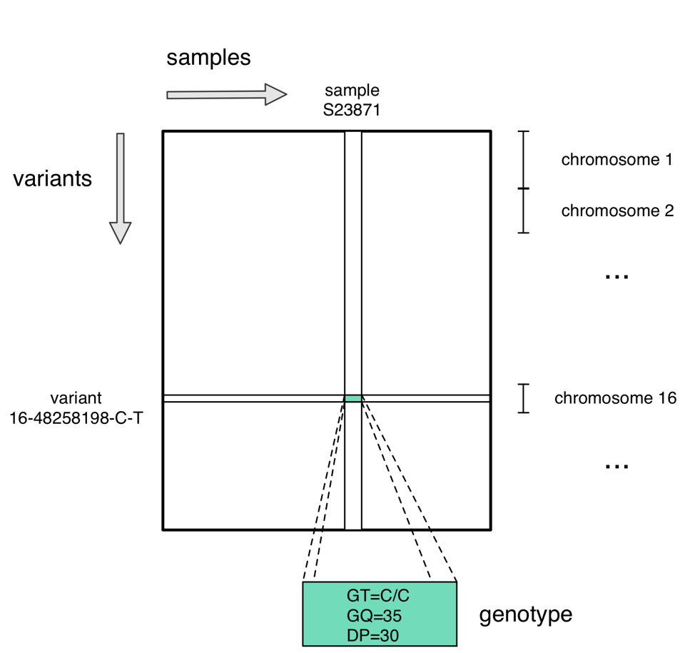
Hail Variant Dataset (VDS)

Slide 27
VDS Format
Parquet format
Not one column per sample (doesn’t scale)
Genotypes are stored in one column as either
a compressed custom encoding (default)
a nested array (SQL-friendly)
Read and write using Spark RDDs
Read using SQL engines (e.g. Impala)

Slide 28
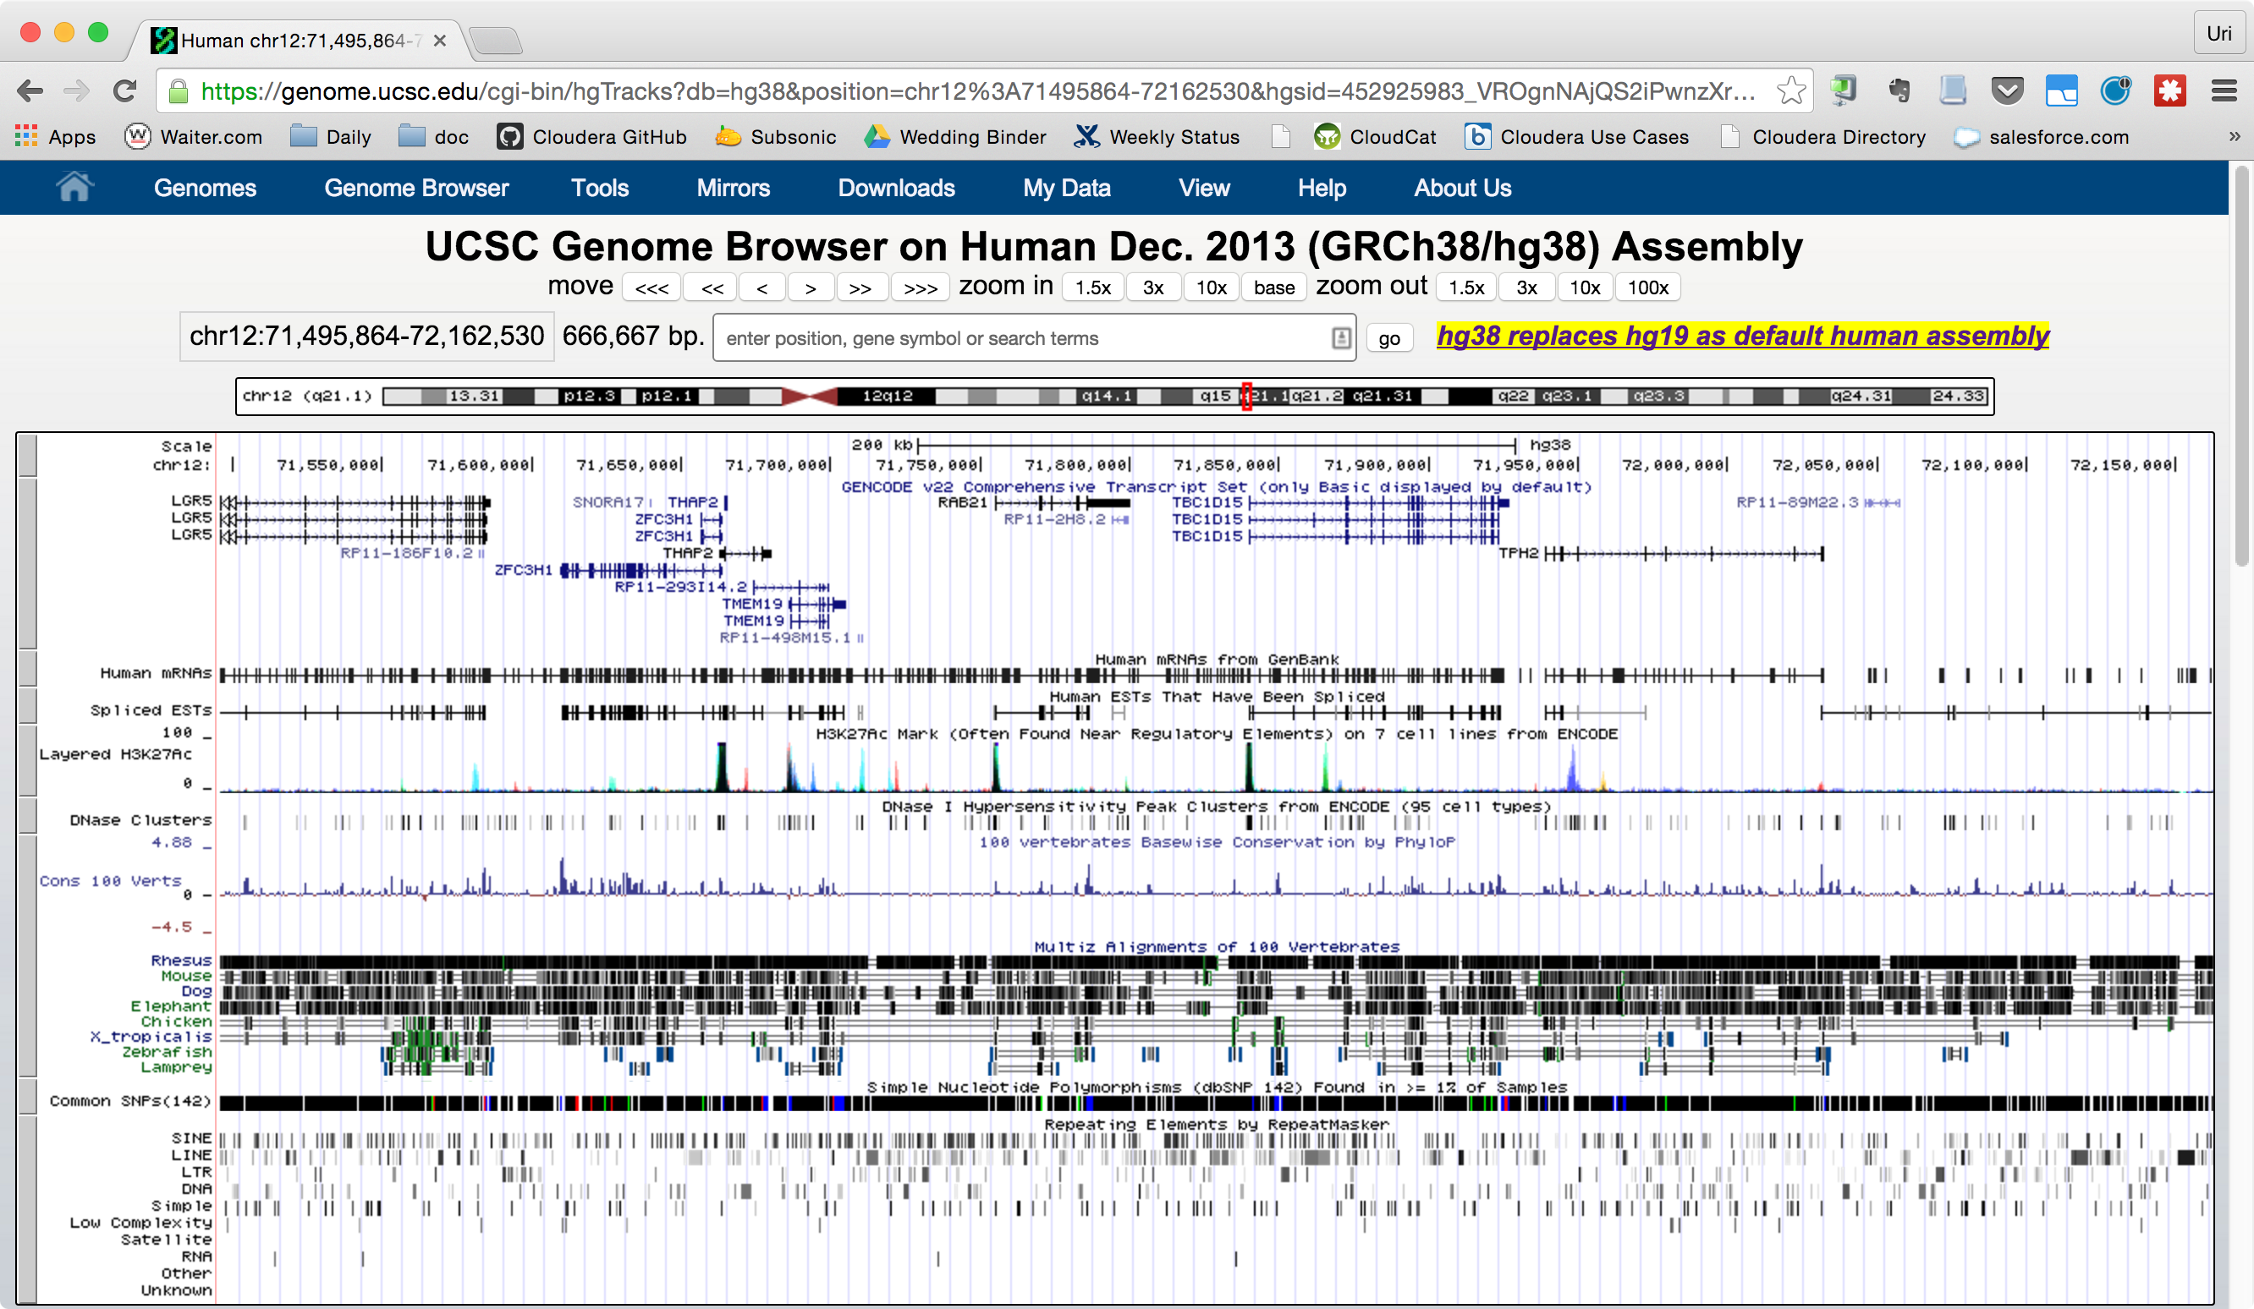

Slide 29
Annotations
Need more than just the reference – annotation databases have information about the biology of the genome
E.g. ENCODE, the Encyclopedia of DNA Elements
Genes and their promoters, regulatory elements, transcripts
Hail makes it easy to join these databases with the VDS as annotations
Sample annotations contain phenotype information (e.g. disease, ancestry)

Slide 31
Hail at Scale
Genome Aggregation Database (gnomAD)
Hail was used for processing and QC analysis on
123,136 exome sequences
15,496 whole genome sequences
UK Biobank
Hail was used to generate GWAS summary statistics for 487,409 individuals
26 billion linear regressions in ~2 hours

Slide 32
Conclusion
Spark is a great fit for large scale genomics
But will need to scale more in future
Get involved!
https://github.com/broadinstitute/gatk
https://github.com/hail-is/hail
Thanks: Broad Institute GATK and Hail teams, industry collaborators

Slide 33
Tom White @tom_e_white

Slide 34
BAM files
Reads
Position
Sequence

Slide 35
OHDSI: Real World Evidence

Slide 36
Observational Health Data Sciences and Informatics
Randomized Controlled Trials
Research-driven
Small (thousands)
Expensive, time-consuming, may not generalize
Observational Data
Real-world healthcare delivery
Large (millions)
Integration challenge
Electronic health records
Insurance claims
Pharmacy records, etc.
https://www.ohdsi.org/who-we-are/

Slide 39
OHDSI and Hadoop/Spark
Common Data Model as Hive tables
Query using Impala or Spark SQL
Several OHDSI projects working with Hadoop
Descriptive statistics (ACHILLES)
Web UI for conducting scientific analyses (Atlas)
Lots of potential for machine learning with Spark ML
Also, integrate with genomic data

